Slide 1

Educational
Multi-institutional
Program for
Instructing
REsidents
(EMPIRE)
“Hidden Curriculum” Webinar Series
Gina Badalato, Miyad Movassaghi, Alexander Small,
Michael Smigelski and Akhil Saji

Slide 2
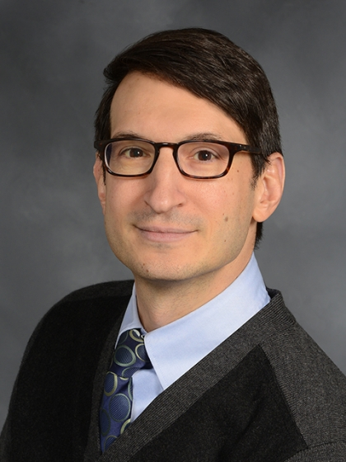

April 29TH, 2021
“Financial Literacy and Management Principles
for Early Career Physicians”
Speaker: Sotirios Keros, MD

Slide 3
EMPIRE “Hidden Curriculum” Series
Purpose: The purpose of the ‘Hidden Curriculum” series proposed by the EMPIRE team is to provide resources that help trainees and early-career urologists transition from training to practice, focusing on topics ranging from burnout, advocacy, contract negotiation, leadership, promotion, malpractice and financial literacy.
Target Audience: This activity was developed for physicians (Urologists) - Attendings, Residents and Fellows.
Activity Objectives: At the conclusion of this activity, the participants should be able to:
Identify resources to help with debt management, insurance, taxes and investing
Improve financial literacy for early-career urologists
Accreditation Statement: This activity has been planned and implemented in accordance with the accreditation requirements and policies of the Accreditation Council for Continuing Medical Education (ACCME) through the joint providership of the University of California, Irvine School of Medicine and New York Section of the American Urologic Association. The University of California, Irvine School of Medicine is accredited by the ACCME to provide continuing medical education for physicians.
Designation Statement: The University of California, Irvine School of Medicine designates this live online activity for a maximum of 1 AMA PRA Category 1 Credit™. Physicians should claim only the credit commensurate with the extent of their participation in the activity.
California Assembly Bill 1195
This activity is in compliance with California Assembly Bill 1195, which requires continuing medical education activities with patient care components to include curriculum in the subjects of cultural and linguistic competency. For specific information regarding Bill 1195 and definitions of cultural and linguistic competency, please visit the CME website at www.cme.uci.edu.
CME Certificate: You will receive a link via email at the end of the month to claim credit for this activity.
Faculty List: Sotirios Keros, MD
Agenda: Thursday, April 29nd, 2021 at 7:00pm – 8:00pm
Disclosure Statement: None of the directors, planners, speakers, moderators, peer reviewers of this activity has any relevant financial relationships to disclose. All planners and moderators with conflicts defer to others without conflicts when planning, moderating any content with which they have a conflict; all speakers with conflicts submit their materials in advance for peer review. This is how all conflicts for this activity are mitigated. Our goal is to present balanced, unbiased, objective, evidence-based, clinically relevant content.

Slide 4
CME
You will receive a survey from Michele Paoli
****Please complete to get the CME certificate
**Please use the Q&A function to ask questions today
ALL UPCOMING WEBINARS (REGISTRATION) ARE LISTED ON THE NEW YORK SECTION WEBSITE:
WWW.NYAUA.COM

